Slide 1
Tapitalist
By: Torn ACLP

Slide 2
Overview
Tapitalist is an incrementation game.
A single tap will initially have an incrementation value of $1
Two ways of incrementation:
Increasing incrementation value (By upgrading the character)
Increasing income rate (By hiring friends)
The main idea of the game is to get richer and have fun.
The app also offers a store where the character can spend money to go on vacation, buy luxury items, etc.

Slide 3
Front End
Opening Screen
Character Avatar
Friend Avatars
Store (Buying Backgrounds)
Color Scheme

Slide 4
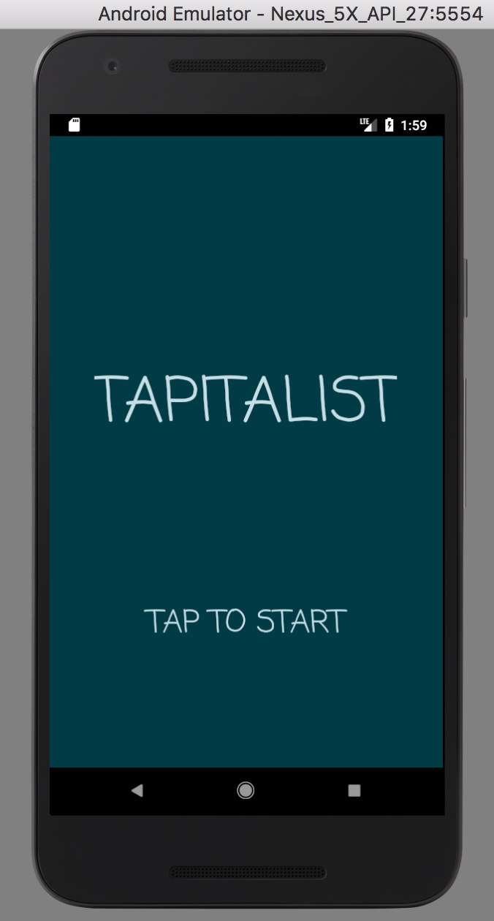
Tap to Start Screen Page
First Activity is displayed
1 text box (Tapitalist)
1 blinking button (Tap to start)
When button is pressed, second activity (Main activity) is displayed

Slide 5
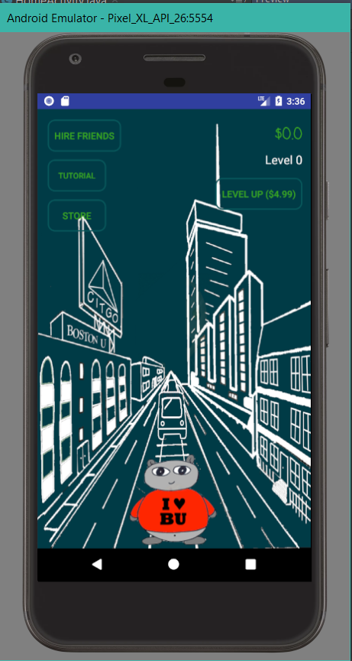
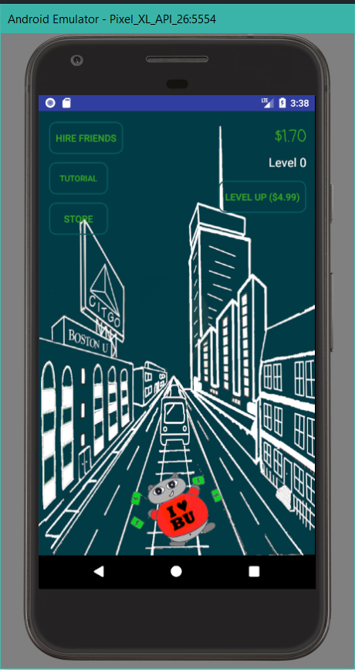
Interface of the Game
Second Activity(Main activity)/Main Menu
Top right corner has amount of money and level of character
Base incrementation value is $0.1.
Base cost to level up is $4.99
Left picture is result of tapping 17 times (money is $1.70)

Slide 6
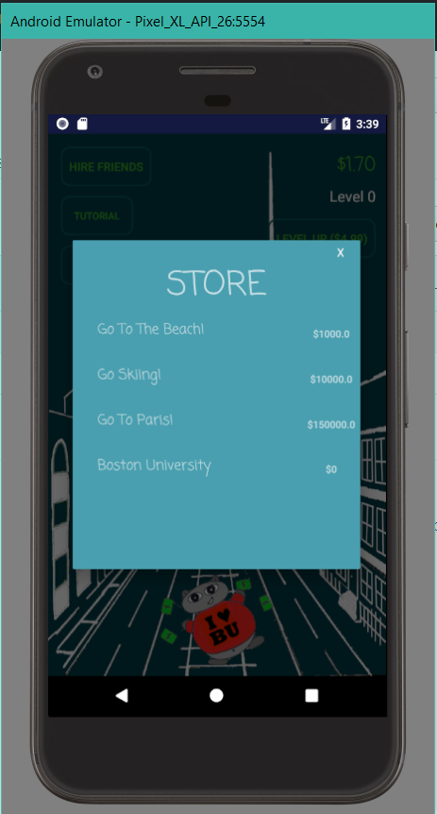
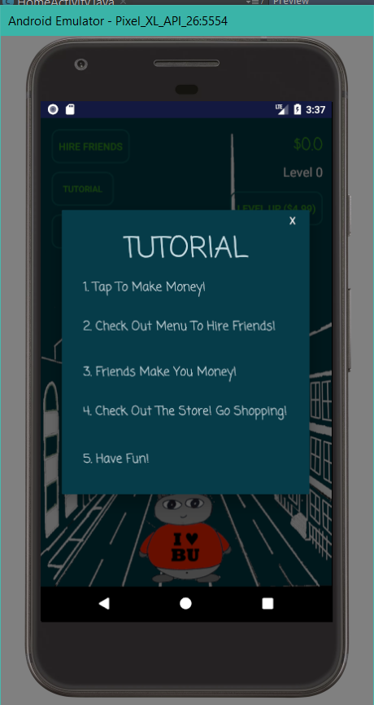
Store and Tutorial
The store button has backgrounds which the player can purchase
The tutorial button gives a brief set of instructions of how to play the game

Slide 7
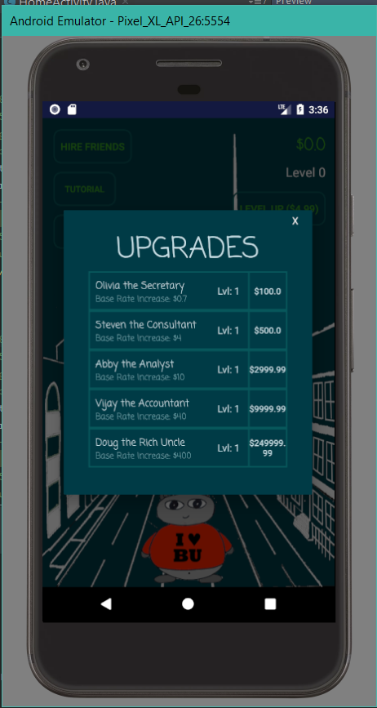
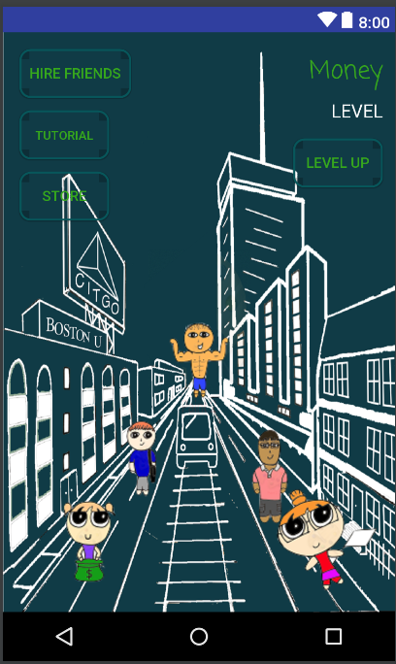
Upgrades
“Hire Friends” buttons provide upgradables
The friends provide income rate which increases the character’s money without the need of tapping
Each friend has their own level as well
The right picture is what the setup will look like if all friends are hired

Slide 8


Character Avatar

Slide 9




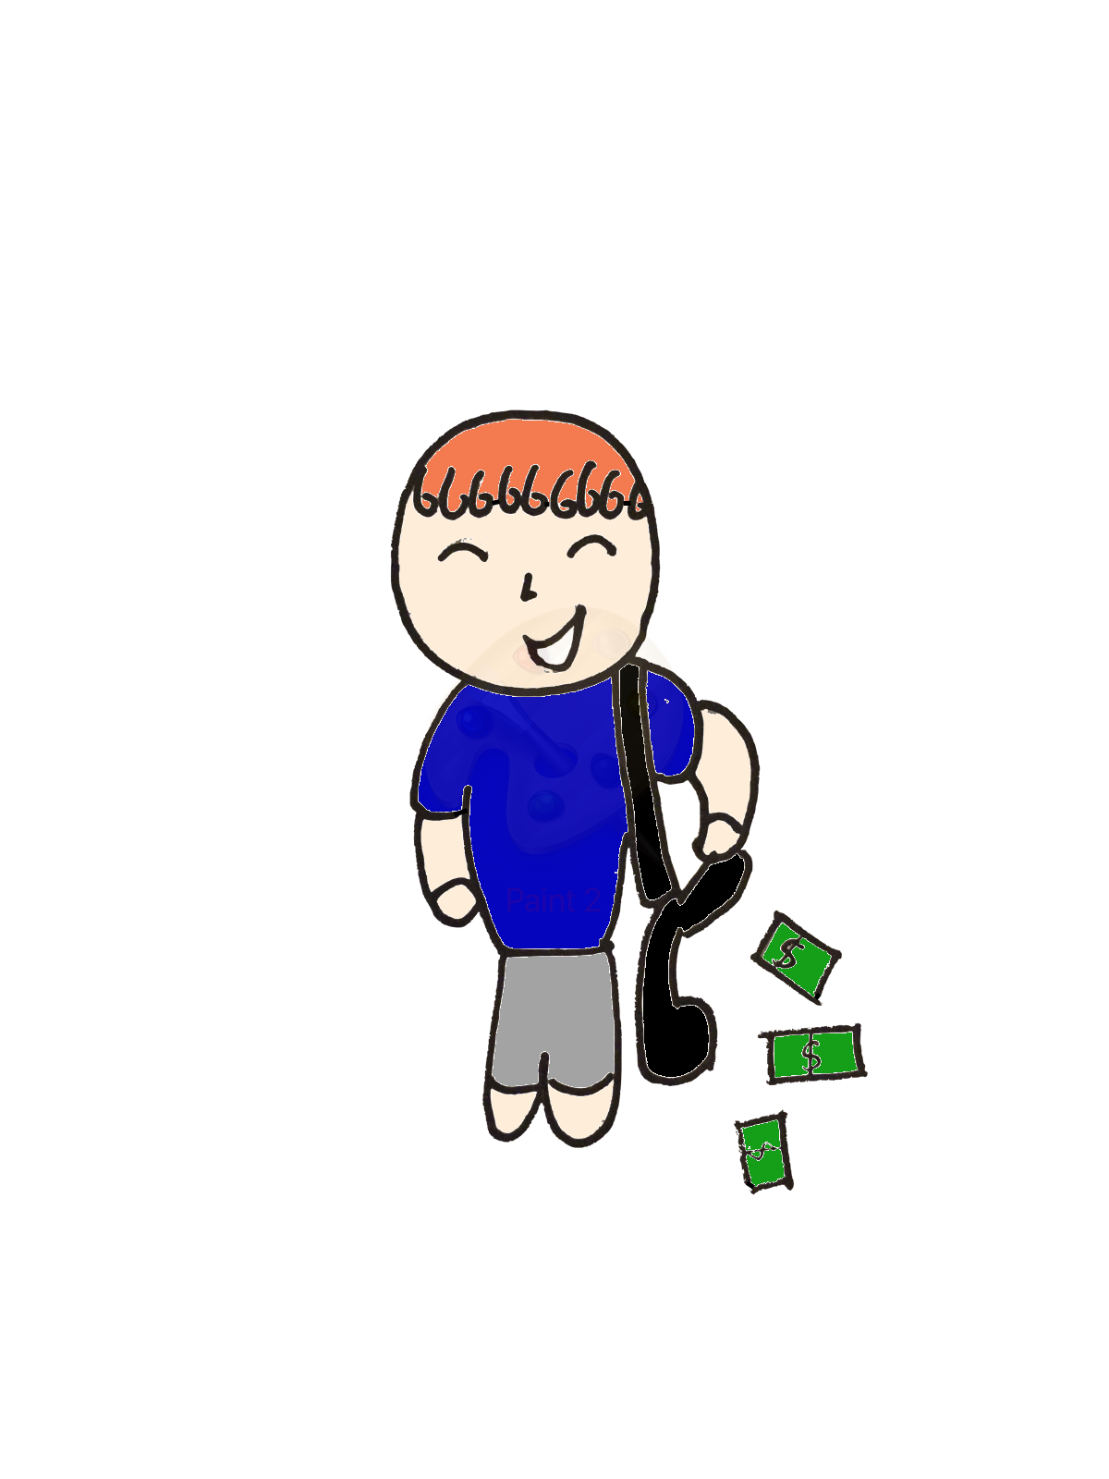

Friend Avatar
Olivia the Secretary
Abby the Analyst
Stephen the Consultant

Slide 10


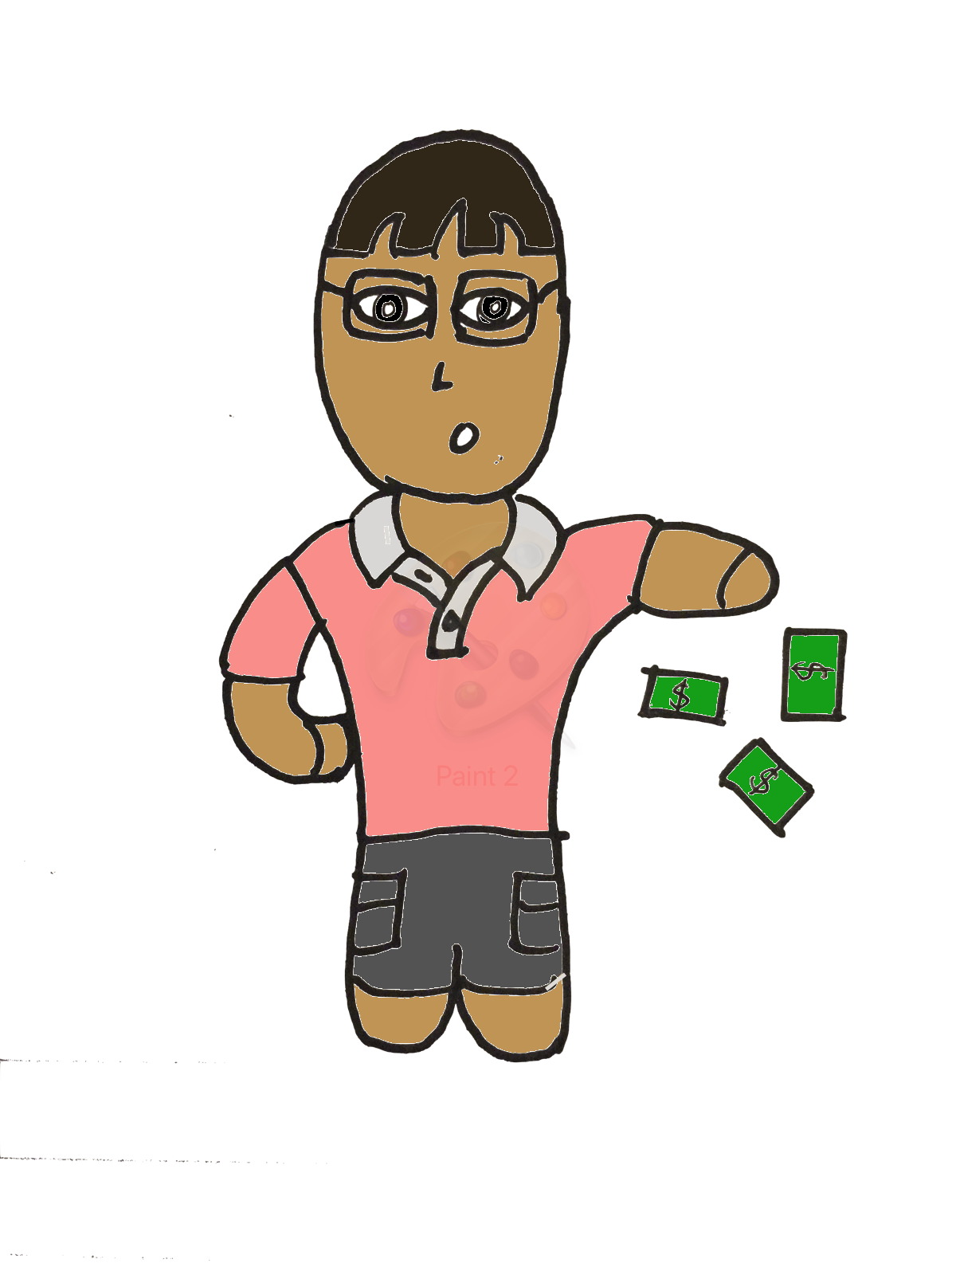

Friend Avatar
Vijay the Accountant
Doug the Rich Uncle

Slide 11

Color Schemes
Cool Blues

Slide 12


Store (Buying Backgrounds)
Go to Beach
BU

Slide 13


Go to Paris
Go Skiing

Slide 14
Back End
Mathematics is required for the values and prices of the incrementation value and income rate.
The prices and values cannot be linear, it will be boring for the players. It cannot be predictable
By upgrading (level up) the character, the incrementation value can increase.
By upgrading (level up) a friend, the income rate can increase.
The incrementation value increases the character’s money by every tap.
The income rate increases the character’s money within every 5 seconds using a timer.

Slide 15
Back End: Incrementation Value
Calculating the incrementation value and the price the character requires mathematics
The incrementation value and its price will both be as a function of the level
Level refers to the amount upgrades for the character
The incrementation value function will be linear
The price will be exponential

Slide 16
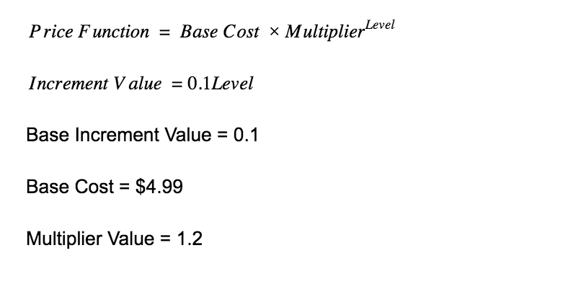
Mathematics of the Incrementer (Upgrading Avatar)

Slide 17
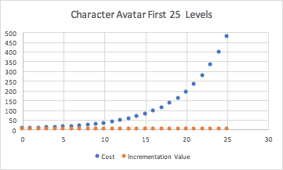
The cost function is exponential while incrementation value is linear.
This increases the difficulty of the game

Slide 18
Back End: Income Rate
Calculating the income rate and the price of upgrading each friend requires mathematics
The income rate and its price will both be as a function of the level
Level refers to the amount upgrades for each friend. Every friend will be in different levels
The income rate function will be linear
The price will be exponential

Slide 19
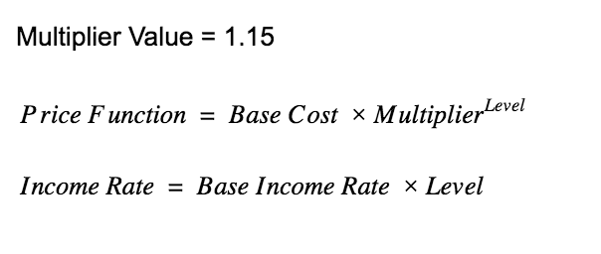
Mathematics of the Price and Income Rate (Friends)
Friends | Base Cost (Cost at Level 0) | Base Income Rate (Income Rate at Level 0)
Olivia the Secretary | 100 | 0.7
Steven the Consultant | 500 | 4
Abby the Analyst | 3000 | 10
Vijay the Accountant | 10000 | 40
Doug the Rich Uncle | 250000 | 400

Slide 20
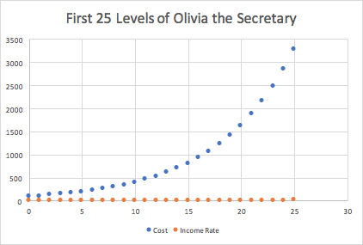
The cost function is exponential while income rate is linear.
This maintains the difficulty of the game. Reducing boredom for the player.

Slide 21
Timer
Based on the Java Timer API.
Create timer tasks and use the scheduleAtFixedRate function to repeat a task at every “x” milliseconds.
Function is called once player hires a “friend”
Cancel function is called to delete the previous
Replaced by a new task that generates an increased income rate
5000 milliseconds is used as the interval

